Slide 1
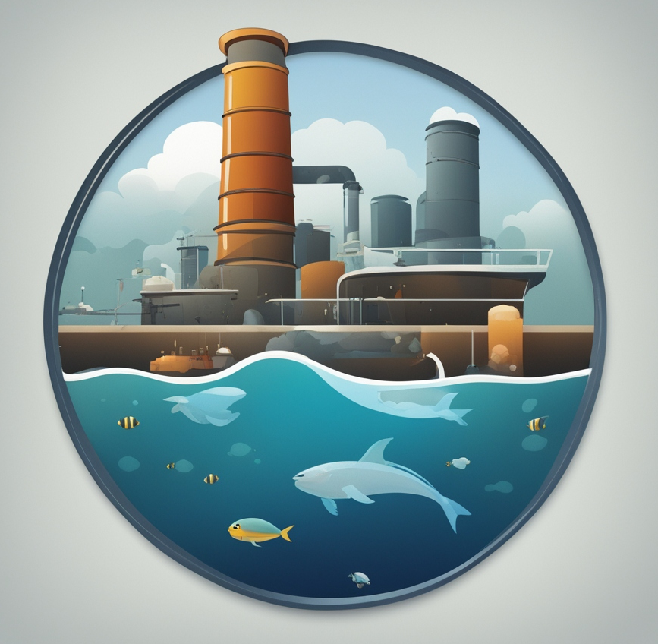



Ocean Inc.
The Oceanic-Industrial Management Game
by Group 1: Diego Bravo, Nick Filipov, Alejandro Bravo, Jose Bolanos
Notes:
Diego

Slide 2
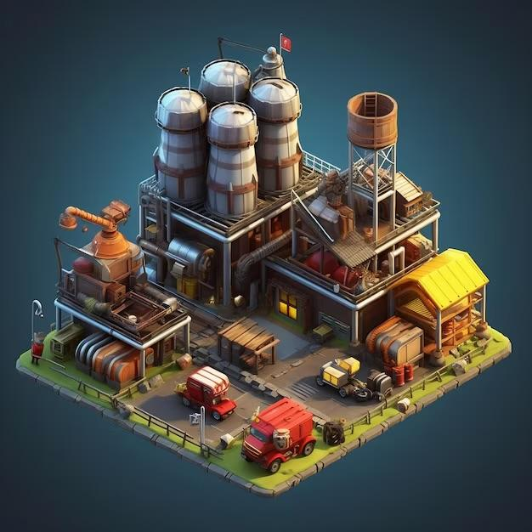
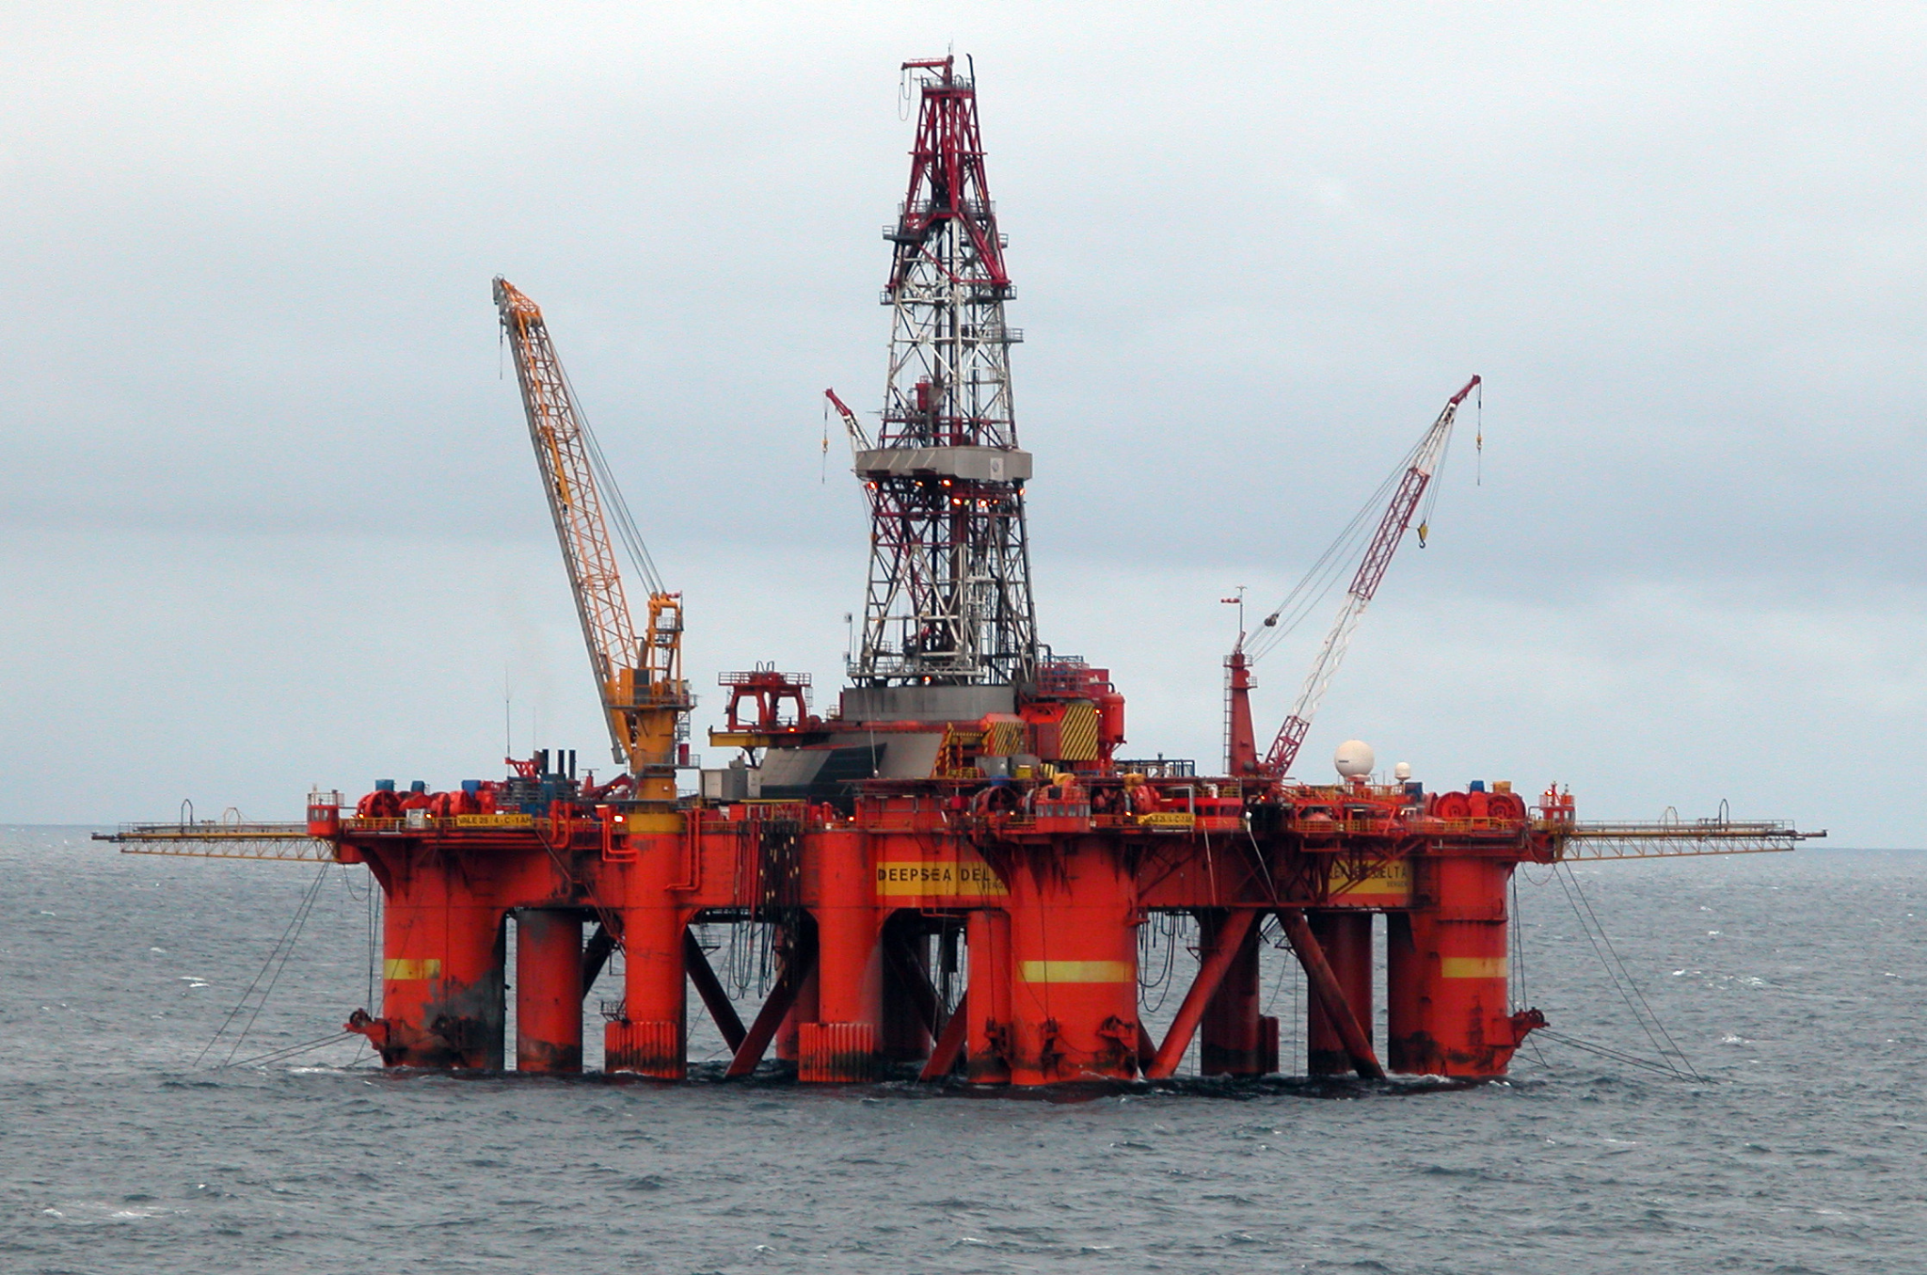
Application Idea
This is an industrial management game set in the ocean or coast.
Player must expand their factories, build oil rigs, dispose of waste, and generate wealth to grow an industrial empire. Meanwhile, the sea level rises and rapidly generates industrial-sourced pollution in the ocean.
The objective of the game changes once the player has caused enough damage to the Earth’s oceans.
Player must mitigate or remediate the damage, otherwise the environmental effects will destroy their factories.
Notes:
Diego

Slide 3

Design Goals
The game’s goal is to serve as an environmental simulator that raises awareness of ocean pollution and climate change from industrial buildings by focusing on the following areas,
Track real-time Industrial impact based on all in-game actions taken by the players.
Process the in-game data to generate the environment and the impact reports to help players understand the consequences of their actions.
Environmental accuracy must properly show the user a realistic representation of ocean pollution.
Real-time environmental alerts for pollution like increasing sea levels and high levels of pollution.
Notes:
Nick

Slide 4
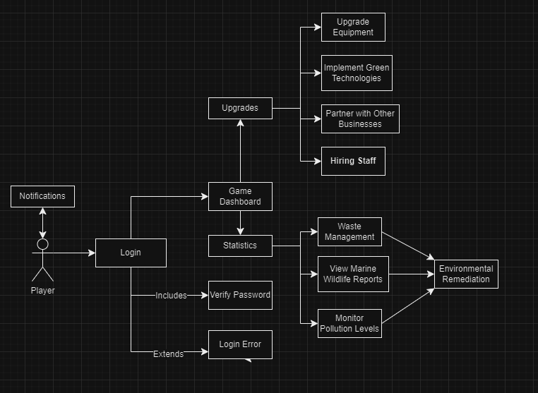
System Design
Application’s main functionality is to immerse the players into an industrial simulation with emphasis on learning about environmental impacts.
A database will be required to hold user information and player progress to allow dynamic updates and adjustments for player actions.
The system can be divided into various player actions such as creating a new game, placing and upgrading factories, and more.
Subclasses would be classes that calculate the production and pollution rate, as well as environmental changes.
Notes:
Nick

Slide 5
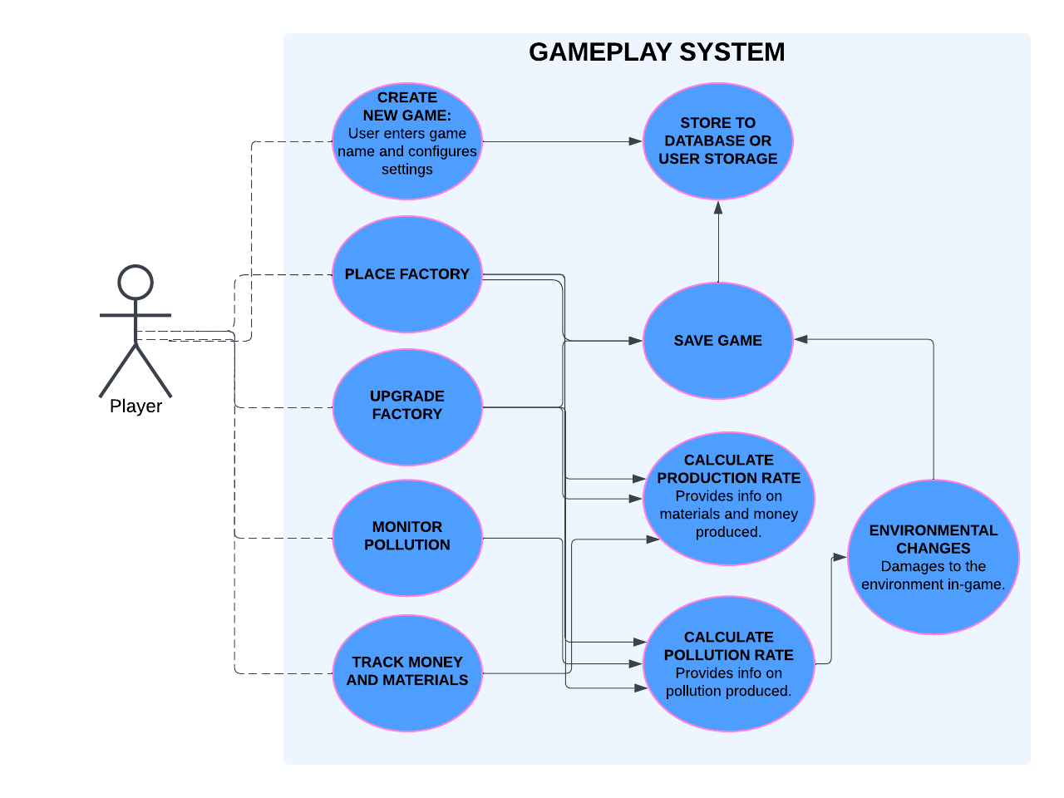
Product Use Case 1
Player creates a new game
User installs game and launches it.
User loads into the main menu.
User selects “New Game” button on main menu.
The game prompts the user to enter a name for the new game.
User enters a name and the game initialization begins.
The system saves the game to storage on creation.
Notes:
Diego

Slide 6
Product Use Case 2
Player places a factory
User installs game and launches it.
User loads into or creates a new saved game.
User selects a factory from the build menu, then dragging it into the area of play.
The system calculates the new production and pollution rate.
The system saves the game to storage.
Notes:
jos

Slide 7
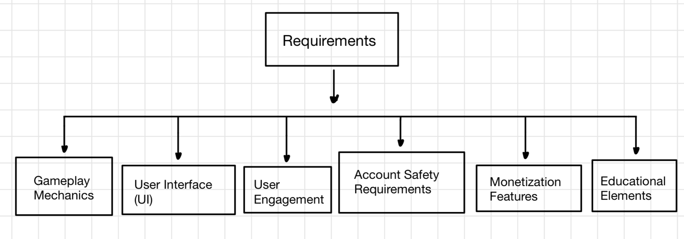
Requirements
Resource Management: Players manage materials, energy, and waste by setting up factories, oil rigs, and disposal systems to expand their industrial empire.
Environmental Impact Feedback: Players get real-time feedback on the environmental effects of their actions, such as pollution levels and sea level rise.
Health and Status Indicators: Visual gauges show pollution, resource levels, and sea level to keep players informed of game status.
Secure Login System: Implement secure login with OAuth2, allowing sign-in through trusted accounts like Google, Facebook, or Steam.
Notes:
Jos

Slide 8
Testing
Software engineers would have to test that core features are implemented with minimal bugs. Some examples of the testing that will occur:
Types of tests | What's needed/collected | Expected results from test
User storage | Users data values from game like cash, levels, pollution, etc | User information when account is created is saved into database and values from game is stored/saved.
Gameplay features | Users current game values like pollution level, cash, tower levels, production level, etc. | User information will be read and will calculate total production/pollution which is the most important currency in game. Additionally, making sure upgrades within buildings work.
Store | Users credit cards/apple pay/payment methods | in order to ensure a successful game and the ability to maintain the game microtransactions must be working properly.

Slide 9


Potential Project Issues
We will most likely need backing for organizations like Oceana, Coral Reef Alliance, Greenpeace, and many more. in order to be able to make this game to fulfil its objective which is bringing awareness to climate change and its effect to the ocean.
Need investors to be able to pay developers to help create/maintain the game before its release.
Competition of other games may affect performance if game isn't met to its standards.
Trademarks for game name/overall features within game. So, legal teams will be needed to make sure we don't violate anyone's or any game features/trademarks in order to avoid lawsuits.
Make sure we need to abide to laws from foreign countries and adjust code accordingly to laws. Likewise, abide to COPPA laws inorder to ensure a friendly user experience for all ages.

